Slide 1
Activity 0.2 - Consortium meetings and workshops among partners
Consortium meeting № 5 – WORKSHOP 2
Capacity building of the Russian Project partners on
“The Governance Approach”
22 MAY 2020

Slide 2
What are the topics?
Coordination mechanisms and local economic growth
Key issues in the Prozvet Approach
Enterprises and the local context
Definition of Governance
Role of the local actors in governance
The Governance Coordinates: task, relationship, nature, institutionalization
Impact of the governance coordinates

Slide 3
There was a group of cattle ranchers
Who used to sell the milk to dairy small enterprises
entrevista a L carrino
At the price of 30 рублей / литр

Slide 4
The dairy entrepreneurs had a thought
¿Why don’t we gather all of us?
entrevista a L carrino
So we can get the milk at a lower price from the farmers:
:25 рублей / литр !
Ant the farmers had to sell the milk at 25 рублей / литр

Slide 5
Ranchers in response did the same thinking
Why don’t we gather all of us?
In this way, we can ask the dairy entrepreneurs
35 рублей / литр
entrevista a L carrino
35 рублей / литр

Slide 6
50 рублей / литр
X
After a while, the large foreign company closed its factory and moved
The result was that local dairy companies closed!
entrevista a L carrino
And it offered the ranchers to buy milk for
50 рублей / литр

Slide 7
X
After a while, the large foreign company closed its factory and moved to another country
The ranchers’ union and the local dairy entrepreneurs’ union decided that it was better to agree to the price of 28 рублей / литр
entrevista a L carrino
28 рублей / литр

Slide 8
There was another issue!
The cheese has to be transported to the market and the cost was 8 руб / кг
Suddenly the price of transportation went up!
10 руб / кг
28 рублей / литр

Slide 9
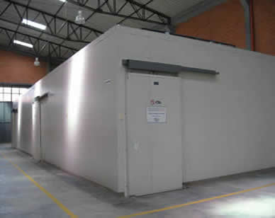
1st Solution
1: Liaise with other farmers and share the transportation costs
2nd Solution
2: Make a cold room shared by all, so as not to go to the market every day
entrevista a L carrino
Ranchers and dairy producers got together, reflected and thought about 3 solutions

Slide 10
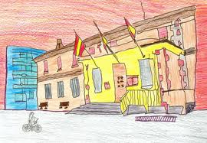
New highway!
Municipality
entrevista a L carrino
3rd Solution
3: They liaised with the Municipality to request the construction of a more direct highway

Slide 11
Once they the highway was built, all of them were very happy
entrevista a L carrino

Slide 12
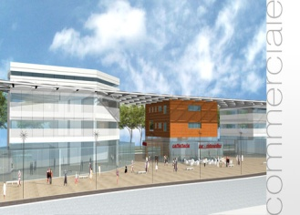
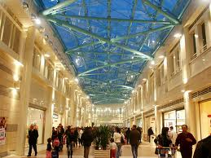
“The appetite came by eating”:
People thought why to stand in one market?
We can enter others!
But the local productive system was not enough
More cows
More dairy enterprises
entrevista a L carrino
More transportation
MISSING

Slide 13
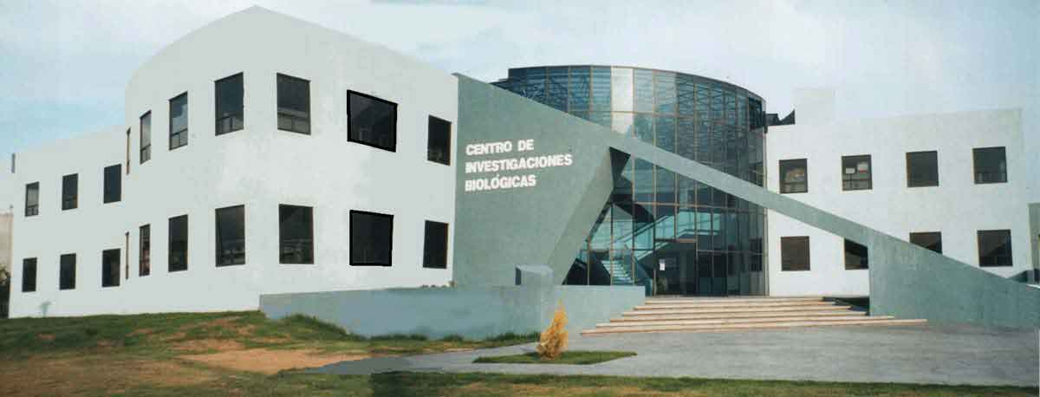
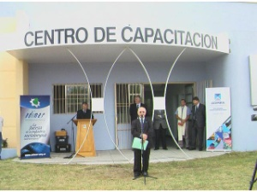
STILL MISSING.
Industrial
Park
Research center
TRAINING CENTER
entrevista a L carrino
Quality Control Unit

Slide 14
Ranchers, dairy producers, other farmer, the business support organizations, the association of female entrepreneurs, the transporters, the municipality and the university set up a Committee, with the task of finding out how to realise the identified missing elements, by using available national plans, international cooperation, and private funds.
The results achieved through the Committee were positively surprising
Three more dairy businesses
The Quality Control Unit
setup
Ranchers doubled the cows, through a creditRanchers doubled the cows, thanks to a credit
The Traning center started up
The project for the establishment of a Quality Control Unit was elaborated
Employment doubled
2 YEAR
3 YEAR
Two more trucks available
Agreement with a large retailing chain signed
The project for a Research Center designed
The Research Center started working
1 YEAR

Slide 15
Exercise N° 1
If you were an association of women and wnat to promote local economic development on your region, with whom would you esanbiish Ian alliance?
A
With the public authorities
With the local entrepreneurs
B
With local actors coming from the public, the private and the social sector
C

Slide 16
HISTORICAL MAP OF THEORIES ON LOCAL ECONOMIC DEVELOPMENT
Krugman e Porter sistematise the concept of External Concentratey Economies
Anthony Giddens, : introduces the concepts of locality and accessibility for explaining the development
A. Vazquez-Barquero introduces the concept of endougenous potential, highlighting the relevance to local civil society collective governance
Piore M. – Sabel discovered the importance of the relationships in a certain delimited territory
G. Becattini
introducs the concept of industrial district
Putnam introduceds the concept of social capital
Mahbub Ul Haq theorises the human development
Neo-marshallian Theories
Bottom-Up development (Stohr)
Local Milieu (Ciciotti, Johannison)
System areas (Garofoli, Secchi)
Local Industrial systems
(Courlet, Pecqueur, Ganne)
Istituzional Theory (Amin)
S. Bagnasco
Highlights specicificyty of territory as development factor
Concept of Collective Learnng
(Camagni, Wilkinson, et and learning regions (Nonaka and Takeuchi)
Millennium
Goals of United Nations
1975
1977
’84
‘86
’88
’93
’98
1970
1990
2015
1980

Slide 17
KEY CONCEPT IN THE PROZVET PROYECT APPROACH IS
DURABLE, LONG LASTING, SUSTAINABLE
DEVELOPMENT
ITS IMPACT IS
Small and medium enterprises and economic actors have low risks of failing
IN ECONOMY
Women and disadvantaged people participate and benefit from the inclusive local approach
IN SOCIETY
Natural resources are not impoverished
IN ENVIRONMENT

Slide 18
Exercise N° 2
If you had to take the decision of approving or not an investment of a chemical factory close to your lake, providing 2000 jobs for your people, what would you decide?
A
I would not approve
B
I would approve
C
I would pass the decision to the national authority

Slide 19
BUSINESSES AND LOCAL CONTEXT
INFRASTRUCTURE
Core
Businesses
RELATED BUSIESSES
SERVICES

Slide 20
INFRASTRUCTURE
Energy
Health Care
Road - Railroad
Communication
Port–Airport
–Rail stations
BUSINESSES AND LOCAL CONTEXT
Allocation
Restoration
Entertainment
Logistics - Distribution
Financial Support
Marketing
Women Empowerment
Complementary
Businesses
Supply chain
Training
Technical Assistance
COMPLEMENTARY BUSIESSES
Support to tourists
SERVICES

Slide 21
About Governance
In the analysis of public policies the concept of governance is used to designate the concrete Government activity
and the concrete participants to the policy making process
rather than the formal governmental institutions (for which the term government is used),
therefore referring to the dynamics, the actual procedures
and not only to what is formally provided in advance by the reference standards.

Slide 22
Exercise N° 3
In your opinion what statement is true and what false
A
Governance regards gobernment activities and participants tot he decision making process
Governance regards the formal government institution and its procedures to support development
B
C
Governance regards the form with which government exercises its executive power

Slide 23
THE ROLE OF THE ACTORS IN LOCAL GOVERNANCE
Public Administration
Realization of the regulatory framework
Realisation of the priority infrastructure
Liaison between the different levels (national-local)
Provision of basic services
Implementation of gender senwitive national policies/Plans/programs
Local Administrations
Decentralised branch of the State
Other public institutions (Education, Health, Research, Finance, etc.)
Public services unities
Entities implementing of gender senwitive national policies/Plans/programs
UNAD
ILS LEDA-REDADELCO

Slide 24
THE ROLE OF THE ACTORS IN LOCAL GOVERNANCE
Private actors
Realization of the Business investment
Updating the economic service and infrastructure demand
Provision of private services
Associations of producers (farmers, industry, artisans, etc.)
Chamber od Commerce
Associations of business women
Associations of tourist operators (hotel, Guest houses, restaurants, etc.)
Private service providers (including university, research centers, training, etc.)
Banks and financial Institutions

Slide 25
THE ROLE OF THE ACTORS IN LOCAL GOVERNANCE
Social actors
Channelling needs and demand
Organisation of civil society, participation, and cohesion
Monitoring social and environmental impact
Associations of civil society
Associations of women
NGO’s and networks
Community base organisations

Slide 26
LOCAL GOVERNANCE
COORDINATES
TASK
Decision-making level
Typology of actors
RELATIONSHIPS
NATURE
Contractual/Structural
INSTITUTIONALIZATION
Formal/Informal

Slide 27
LOCAL GOVERNANCE
COORDINATES
TASK
Lobbyng
Bottom-up pressure for influencing decision makers
Consulting
Decision makers consult other actors, and take decisions accordingly (or not)
Decision makers entrust the governance mechanism decisions about some specific component of the public budget (participatory budgeting)
Semi-decisional
The governance mechanism include all the actors and they take decision on specific issues
Co-decisional

Slide 28
RELATIONSHIPS
Ex: Waste or transportation management
ONE-ONE
1 Public institution entrusts a task to 1 private actor
1 Public institution entrusts a task to more than 1 private actor
Ex: garden maintenance, school food
ONE-MULTIPLE
Ex: local employment, or women empowerment, program contract,
nagotiated planning
Public institutions, private and social sectors make en agreement for planning/implementing some actions
MULTI-STAKEHOLDERS

Slide 29
NATURE
The relationships are regulated by a legal contract
Ex: Service contract
CONTRACTUAL
A new organisation is set up for managing the activities related to the task
Ex: Public Company,
Territorial Pact,
Development Agency
STRUCTURAL

Slide 30
ISTITUTIONALIZATION
Ex: Public Private Partnership Entity
Negotiated regional round table
FORMAL
According to the national legal framework
Territorial Development Committee or Forum
Program Agreement
Local Action Group
Signed agreements between participants, MoU’s, Informal network agreeements
INFORMAL

Slide 31
Exercise N° 4
Which one of the following governance model is more effective for territorial development ?
A
A Multi-Actors decisional Informal Group
B
1-to-Multi Actors decisional formal agreements
C
Multi-Actors decisional formal Group

Slide 32
IMPACT OF THE LOCAL GOVERNANCE
COORDINATES
4. INSTITUTIONALIZATION
Formal
Structural
3. NATURE
2. RELATIONSHIPS
Informal
Contractual
One-Multiple
Multi-stakeholders
One-One
Co-decisional
Consulting
Lobbyng
1. TASK
IMPACT
Semi-decisional

Slide 33
Multi-Actors decisional formal structure
Multi-Actors semi-decisional formal Group
PARTECIPATION
Multi-Actors decisional formal Group
Multi-Actors Consultating table
Multi-Actors decisional Informal Group
1-to-Multi Actors decisional formal agreements
1-to-1 consultating informal groups
IMPACT

Slide 34
THE NEGOTIATED PARTICIPATION IN EUROPE
REFERENCE
Regulation agreed between public actors or between the competent public actors, other public and private parties for the implementation of interventions related to the purpose of development, and defined in a coordinated and harmonious manner.
The institutional agreement between the government and the board of each region that establishes the objectives to be achieved and the sectors in which joint action is indispensable, from the point of view of an advanced model of regional autonomy.
PROGAM AGREEMENTS
FRAMEWORK PROGRAMS
Agreement between local authorities and stakeholders in local development, promoted on the basis of the institutional program agreement
INSTRUMENTOS
PROGRAM CONTRACT
Contract binding the state administration, large companies, SME consortia and representatives of industrial districts, stipulated for the achievement of the objectives of negotiated planning
The PACT is the result of a debate that leads to an agreement between actors, as well as local interlocutors, registered in a strategic document and accompanied by operational or financial commitments adopted by each of them
TERRITORIAL PACT

Slide 35
СОГЛАСОВАННОЕ УЧАСТИЕ
Распоряжение, согласованное между компетентными гос.органами, другими государственными и частными сторонами о проведении мер, направленных на развитие, составленное с учётом скоординированности и гармоничности предлагаемых действий.
БАЗА
ПРОГРАММНЫЕ СОГЛАШЕНИЯ
Институциональное соглашение между гос.органами и советами в каждом регионе, устанавливающее цели и задачи, которые предстоит достичь, и отрасли, в которых обязательно должны быть проведены совместные мероприятия, с точки зрения продвинутой модели региональной автономии.
Соглашение между местными гос.органами и заинтересованными в местном развитии сторонами, заключаемое на базе институционального программного соглашения
РАМОЧНЫЕ ПРОГРАММЫ
ИНСТРУМЕНТЫ
Контракт, обязательный для исполнения гос.органами (администрациями), крупными компаниями, объединениями МСБ и представителями промышленных регионов, предусматривающий достижение целей и задач согласованного плана
ПРОГРАММНЫЙ КОНТРАКТ
ОБЪЕДИНЕНИЕ – это результат обсуждений и дебатов, ведущих к согласию между участниками, а также местными сторонами, зарегистрированное в стратегическом документе и сопровождаемое функциональными либо финансовыми обязательствами, которые каждый из них принимает на себя
ТЕРРИТОРИАЛЬ-НОЕ ОБЪЕДИНЕНИЕ

Slide 36
From OECD:
In many OECD countries, national, regional and local governments have started their local economic development activities under the operational control and supervision of corporate structures (called companies, agencies, corporations), instead of administering them directly within the framework of a public platform (a departmental council or service management).
This approach is now widespread internationally
(By an OECD research “ Organising for local development: the role of local development agencies”, 2009)

